Slide 1

气象数据处理分析的软件工具介绍 Useful tools in meteorological data analysis
江（Jiang） 宇超（Yu-Chao）
jiang@wni.com ; jychstar@163.com
Weathernews America Inc.
June 3, 2018 at
Notes:
yufengdai@itpcas.ac.cn

Slide 2
Outline
Introduction of myself and my company
Awareness and critical thinking
Open dataset: Satellite, GFS, etc
free software tools and programming libraries
(short break)
Python data analysis and machine learning
Python deep learning for image recognition
Matlab example for LandSat
Q&A
feel free to ask any question at any time. The best way to learn is interacting with new things

Slide 3
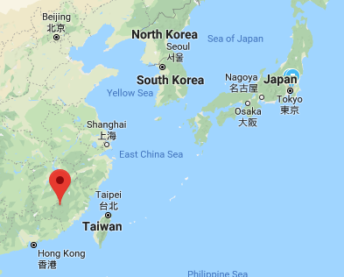
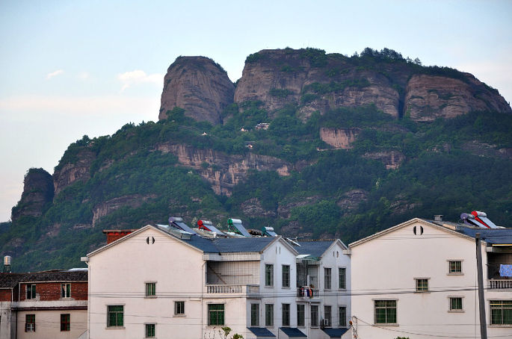



Introduction
Grew up in FuJian(福建).
2007, B.S. in Applied Physics.
2010, M.S. in Material Physics.
2016, Ph.D. in Electrical & Computer Engineering.
2017 Data Analyst at Weathernews America Inc.

Slide 4
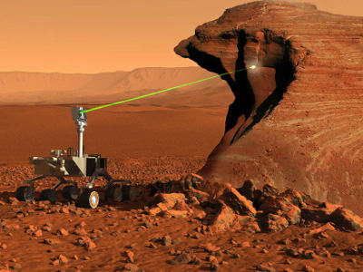
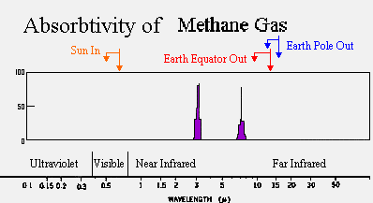
Introduction
Research on mid-infrared lasers
Interband cascade laser, picked by NASA to detect atmosphere of Mars.
Special wavelengths (3 - 11 micron), highly sensitive to gas molecular (e.g. methane), ppb (1 per billion).
Highly energy efficient! 1/10 of competitor. Using iphone 6 battery (10.5 Wh) can work ~50 hours.

Slide 5
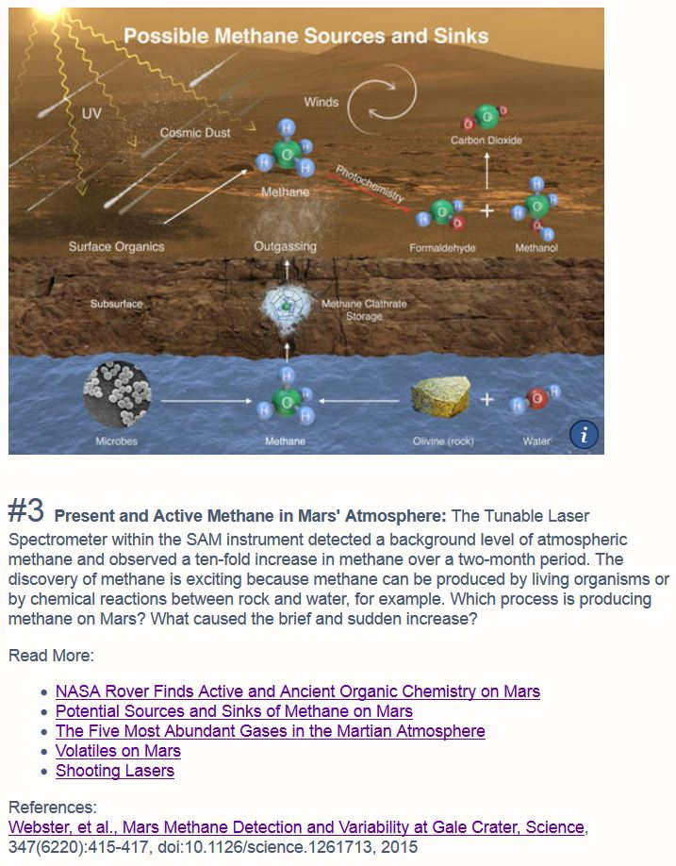
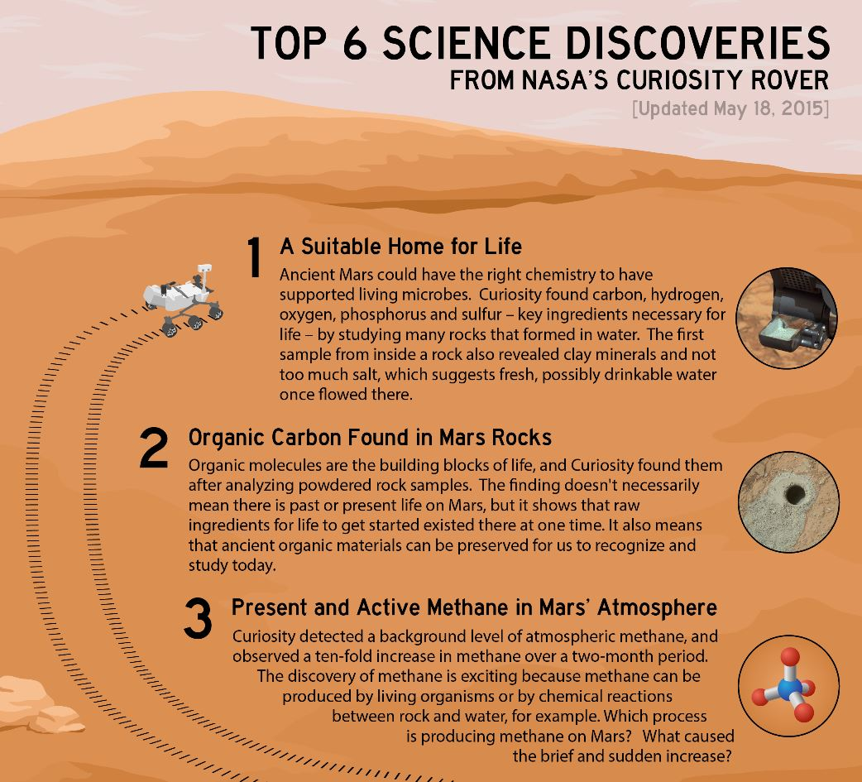
http://mars.nasa.gov/msl/mission/science/results/
Notes:
Now let’s see what are scientific discoveries by the curiosity rover. No.1. It found some key ingredients for life, such as carbon, hydrogen, oxygen ,phosphorous and sulfur. No. 2, it found organic molecules. No. 3, It found methane. It observe 10 fold increase in methand over a 2-month period. This is very exciting because methane is the very evidence of early life.

Slide 6

Introduction
About Weathernews
headquarter in Chiba, Japan
founded in 1986 by Ishibashi to protect mariners
>700 employees, largest company in meteorology business
2018 Winter Olympics
tailored weather predictions and voyage planning
enterprise level service + customer level app (only Japan)
collaborate with Chinese app Moji(墨迹）
provide aviation forecasting to many airports in China
still expanding business globally

Slide 7

Awareness and critical thinking
What do you expect to learn in a lecture/workshop:
what exists
where to find resources
basics to get you started
A “yes, I can learn everything” mindset
Bonus 1: “how to learn” tips
Bonus 2: “how to think” tips

Slide 8
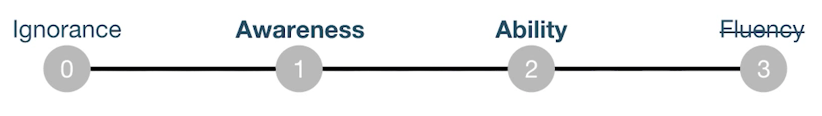
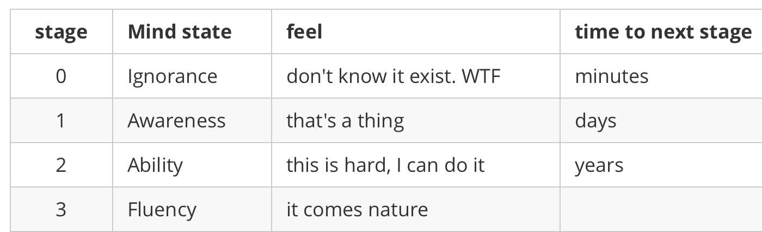
Awareness and critical thinking
How to learn new things:
break a whole chunk into small pieces
10,000 hours rule
timely, expert feedback (classroom beats online )
ignite your curiosity/potential

Slide 9
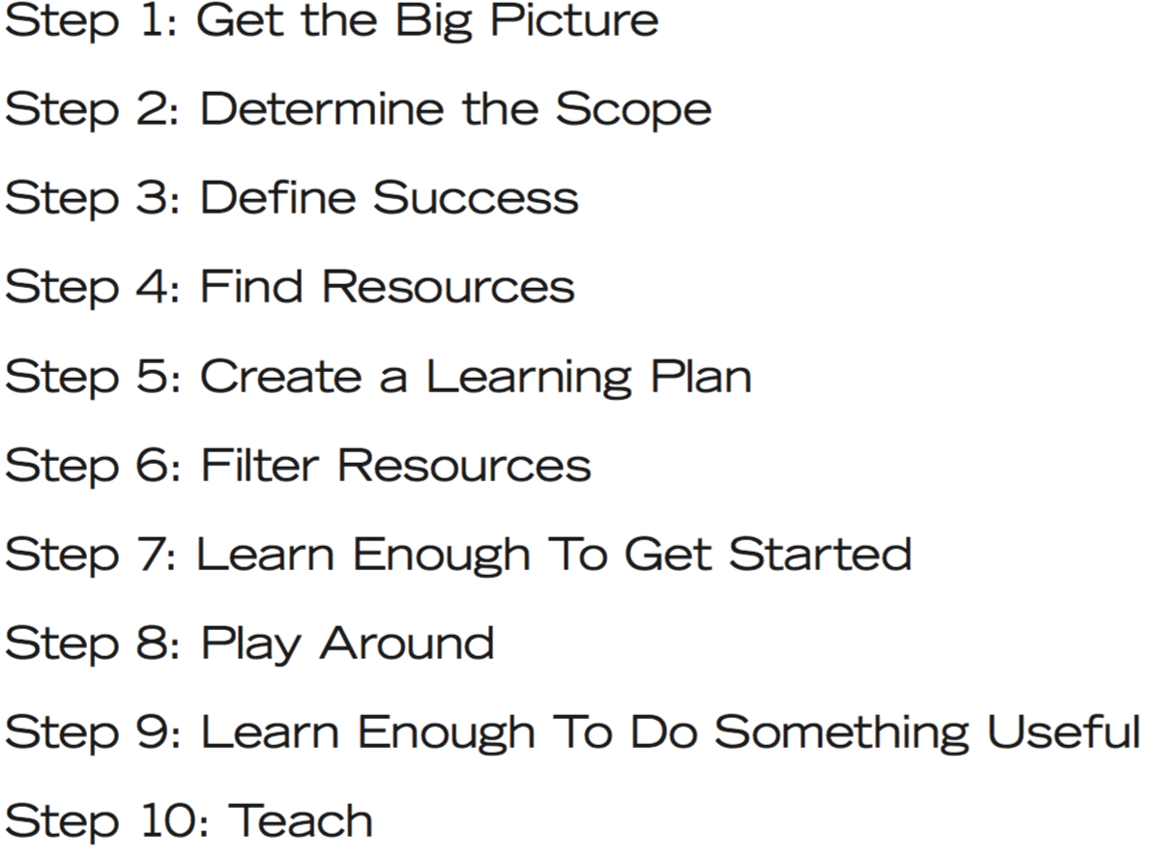
Awareness and critical thinking
10 steps to learn anything quickly：(http://simpleprogrammer.com)
You and me,
only 9 steps away
Notes:
10 Steps to Learn Anything Quickly
bought on 2016-6-8 for 99 USD
may request author for updates.

Slide 10
Awareness and critical thinking
Why critical thinking is rarely taught?
easier taught if knowledge is framed inside a box
a cross-discipline thing– who is going to teach?
Some strategies for critical thinking/question:
each domain has its own specialized knowledge
performance cost ratios (nothing comes free)
end-goal oriented vs. follow your mood/heart
trust evidence? intuition? authority?
causal relation(A->B) vs. correlation(A link to B)
physical approach(100% sure) vs. AI approach(probability guess)

Slide 11
Open dataset： satellite
freely available satellite data:
GOES-16 (Geostationary orbit environmental satellite, by NOAA) https://www.goes-r.gov/products/samples.html
16 band: http://cimss.ssec.wisc.edu/goes/webapps/bandapp/overview_goes_16.html
slider: http://rammb-slider.cira.colostate.edu/
Himawari-8 (by Japanese Meteorology Agency)
http://www.data.jma.go.jp/mscweb/en/himawari89/
LandSat (by USGS)
https://landsat.usgs.gov/landsat-data-access

Slide 12
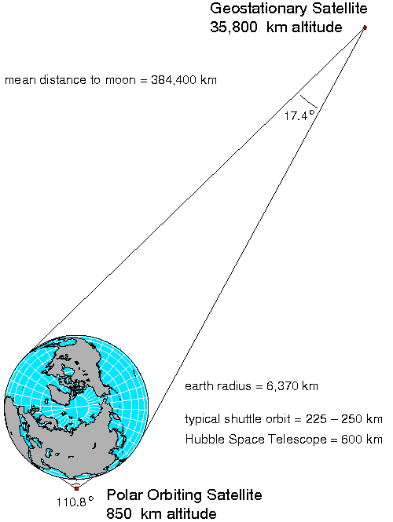
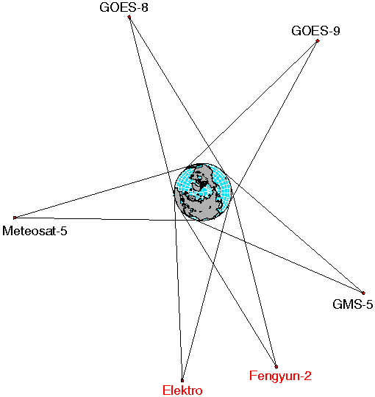
Open dataset： what is a geostationary satellite?

Slide 13
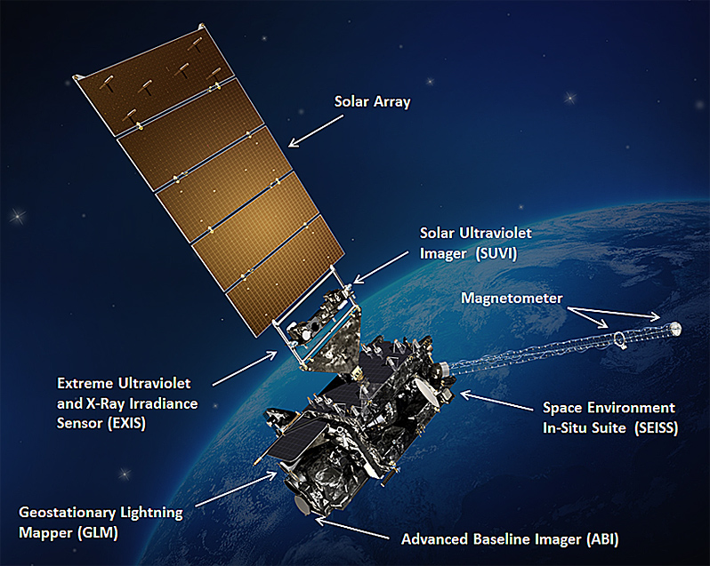
Open dataset： what is a geostationary satellite?

Slide 14
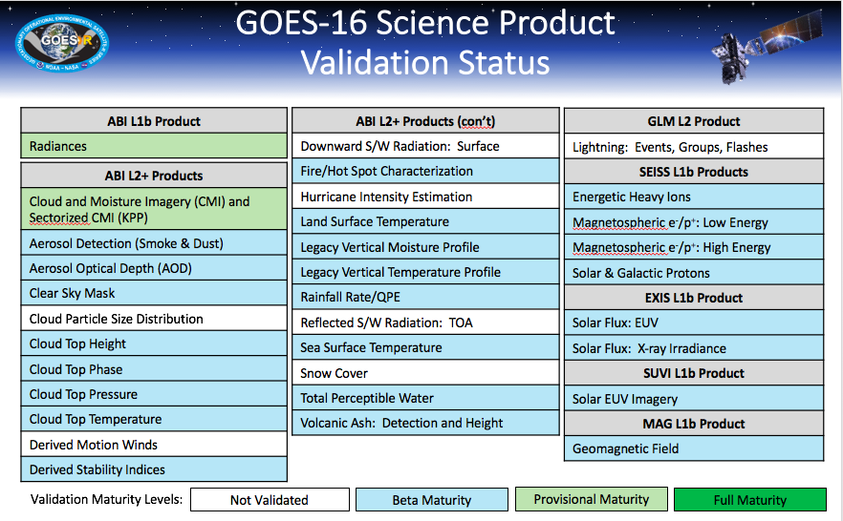
Open dataset： geostationary satellite

Slide 15
Open dataset: GFS
Global Forecast System (GFS)
run by US NOAA, freely available
run 4 times a day, produces 16 days forecasts
horizontal resolution: 13 km
vertical resolution: 64 layers of air pressure
https://www.ncdc.noaa.gov/data-access/model-data/model-datasets/global-forcast-system-gfs
each dataset: .grb2 file + .inv file
use wgrib2 C library to read .grib2 file
use .inv file to find name for a specific variable
variables: height, temperature,
http://www.ftp.cpc.ncep.noaa.gov/wd51we/wgrib2/tricks.wgrib2

Slide 16
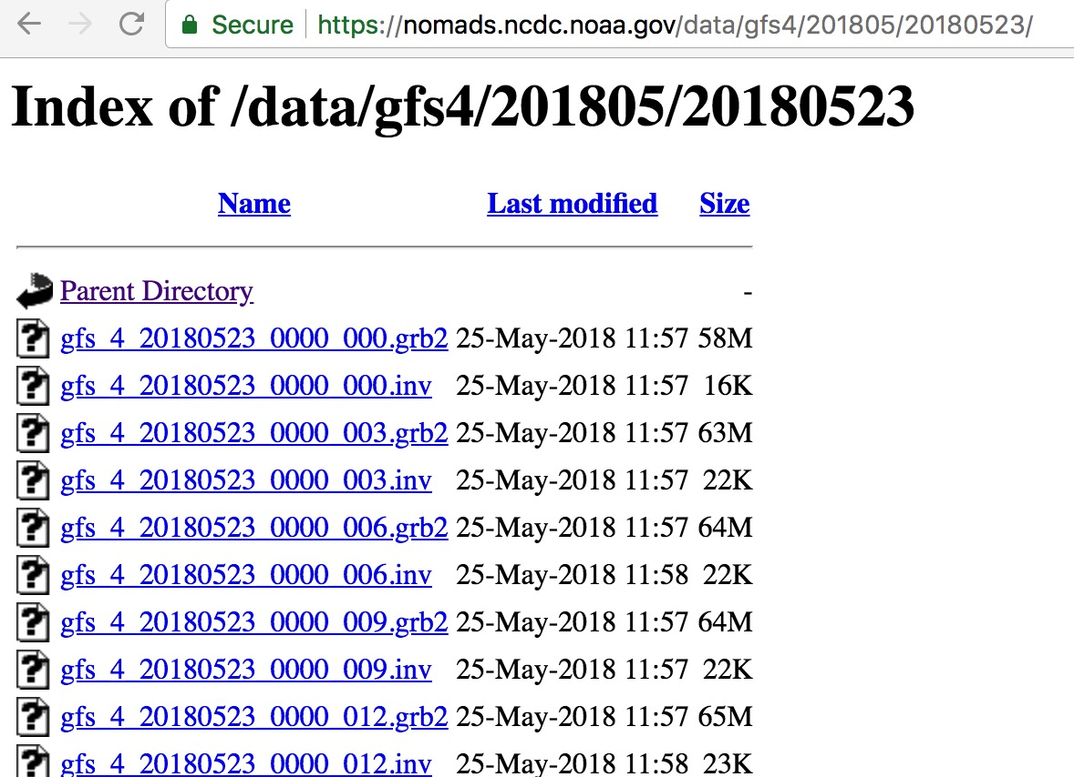
Open dataset: GFS
Notes:
gfs 4 has 0.5 resolution;
gfs 3 has 1.0 resolution.

Slide 17
Open dataset
Notes
Opening up data does not magically solve problems
think beyond simple “wouldn’t it be cool if…?” questions, and think about actual problems that can be solved with the data, and who will benefit from cost savings as those problems are solved.
For learning purpose, you need to understand:
data format (NetCDF, wgrib, binary, tiff)
physical meaning of variables (radiances, coordinates, etc.)
quality of the data (expect preprocessing of raw data)
Notes:
Be bold to ask stupid questions. no one knows everything

Slide 18
free software tools and programming libraries
short survey
Software:
Excel, Origin, ArcGis, Panoply, Endnote,
coding language:
Fortran, C/C++, Matlab, R, Python, Labview, Shell, Perl, JavaScript/PhP, SQL

Slide 19
free software tools and programming libraries
How to choose?
Application/project specific
If a commercial one can do the job, buy one. Saving your time is much more important.
If not, search whether others have developed the tools
e.g. WRF model is written in Fortran
If no preference, use Python.

Slide 20
free software tools and programming libraries
Example: Endnote
my favorite tool to manage journal papers
CAS has bought the license
a quick demo
(sorting, smart folder, insert citation)

Slide 21
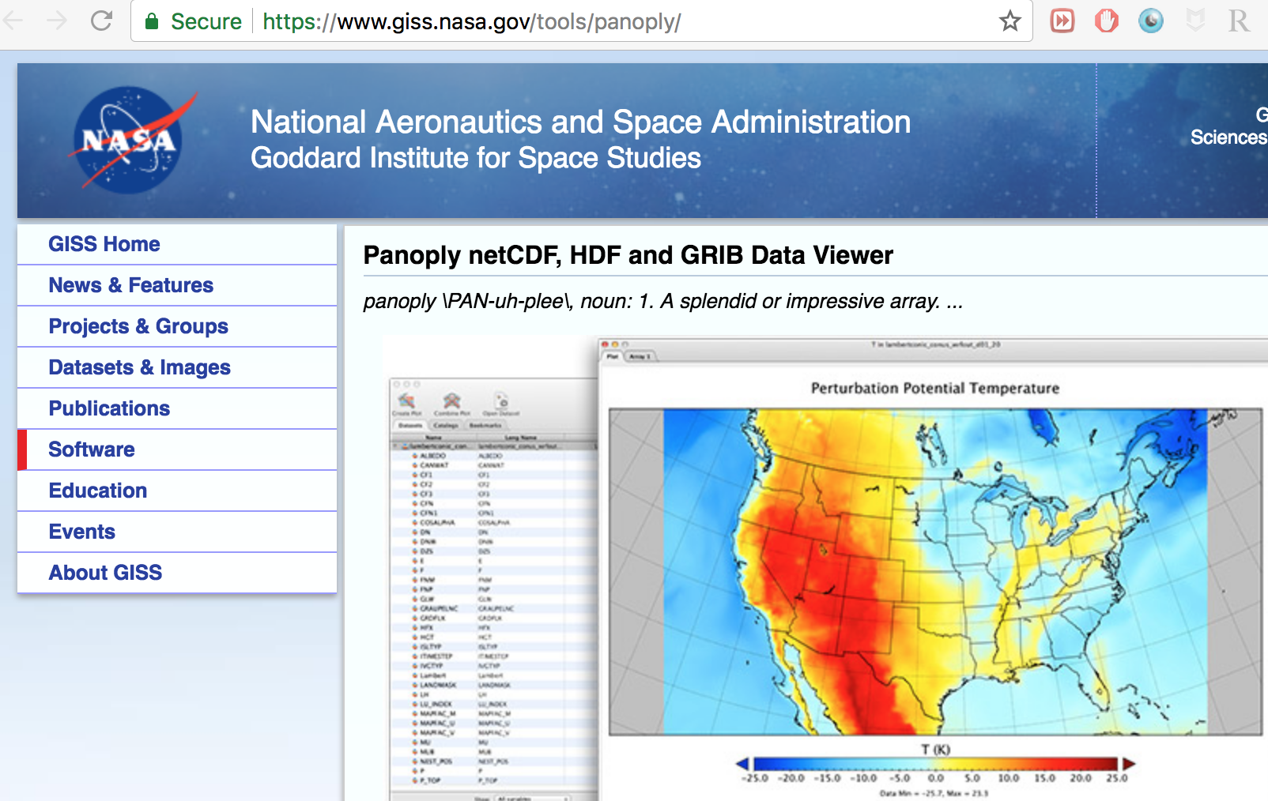
free software tools and programming libraries
Example: Panoply
open NetCDF file (GOES data) for quick glance
free download: https://www.giss.nasa.gov/tools/panoply/
quick demo (variables, attributes, hyperdata, quick plot)

Slide 22
free software tools and programming libraries
Example: netCDF4-python
http://unidata.github.io/netcdf4-python/
```python
from netCDF4 import Dataset
rootgrp = Dataset(filename, ‘r’) # type: netCDF4._netCDF4.Dataset
x = rootgrp['x'][:] # shape (5000,), -0.075 to 0.0649
y = rootgrp['y'][:] # shape (3000,), 0.0426 to 0.1265
cmi = rootgrp['CMI'][:] # shape(3000,5000)
plt.imshow(cmi)
```
much more you can do if you can code
Notes:
python_CMI folder

Slide 23
free software tools and programming libraries
Why choose Python?
easy to learn, grammar is human readable
very popular, means you can easily find resources to learn by yourself or solution when you get stuck
powerful IDEs, easily render codes & graph together
many free libraries for different purposes:
numpy, scipy, pandas,
matplotlib
opencv
sci-kit learn
tensorflow

Slide 24
Outline
Introduction of myself and my company
Awareness and critical thinking
Open dataset: Satellite, GFS, etc
free software tools and programming libraries
(short break)
Python data analysis and machine learning
Python deep learning for image recognition
Matlab example for LandSat
Q&A
feel free to ask any question at any time. The best way to learn is interacting with new things

Slide 25
Python data analysis and machine learning
Python environment setup
My favorite IDE is jupyter notebook
Anaconda with Python 3 or Python 2:
https://anaconda.org/
use ‘conda install’ to install required libraries
Read official documentations to get a basic idea
numpy: http://www.numpy.org/
pandas: https://pandas.pydata.org/
matplotlib: https://matplotlib.org/
seaborn: https://seaborn.pydata.org/
sklearn: http://scikit-learn.org/stable/index.html

Slide 26
Python data analysis and machine learning
Walk-through example: Titanic dataset
disk location: /Users/yuchaojiang/github_all/datasets_github/titanic
web location: https://github.com/jychstar/datasets/tree/master/titanic
notes:
data preprocessing
data visualization
machine learning

Slide 27
Python deep learning for image recognition
Example: deep learning for self-driving car
video location: /Users/yuchaojiang/udacity/SCND/final
disk location: /Users/yuchaojiang/github_all/nanodegree_github/CarND/p5_vehicle_detection
web location: https://github/jychstar/nanodegree_github/CarND/p5_vehicle_detection
Notes:
have a rough idea what is deep learning
whether it can be used for meteorological application

Slide 28
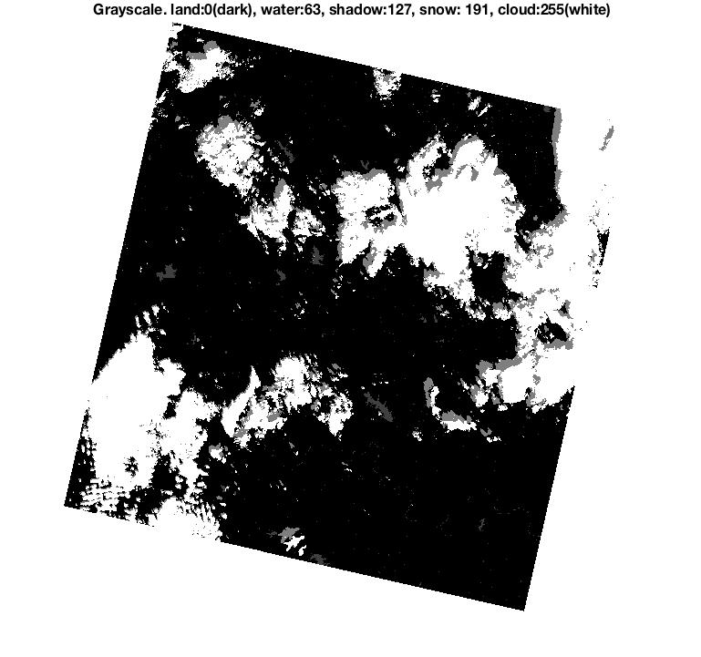
Matlab example for LandSat
Example: Matlab codes for cloud mask
original author: Zhe Zhu at Texas Tech University
https://github.com/prs021/fmask
landsat data: free register then download the tiff data
https://earthexplorer.usgs.gov/
example results: /Users/yuchaojiang/github_all/GOESR-master/matlab_landsat_fmask/image
Notes:
http://pathfinder88.blog.163.com/blog/static/16828525820115297381053/

Slide 29
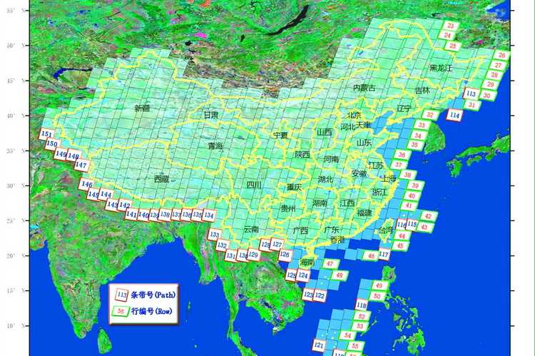
Numbering of Path/Row for LandSat
if use Beijing (132/32) or Tibet area
Notes:
http://pathfinder88.blog.163.com/blog/static/16828525820115297381053/

Slide 30
Outline
Introduction of myself and my company
Awareness and critical thinking
Open dataset: Satellite, GFS, etc
free software tools and programming libraries
(short break)
Python data analysis and machine learning
Python deep learning for image recognition
Matlab example for LandSat
Q&A
feel free to ask any question at any time. The best way to learn is interacting with new things

